Slide 1
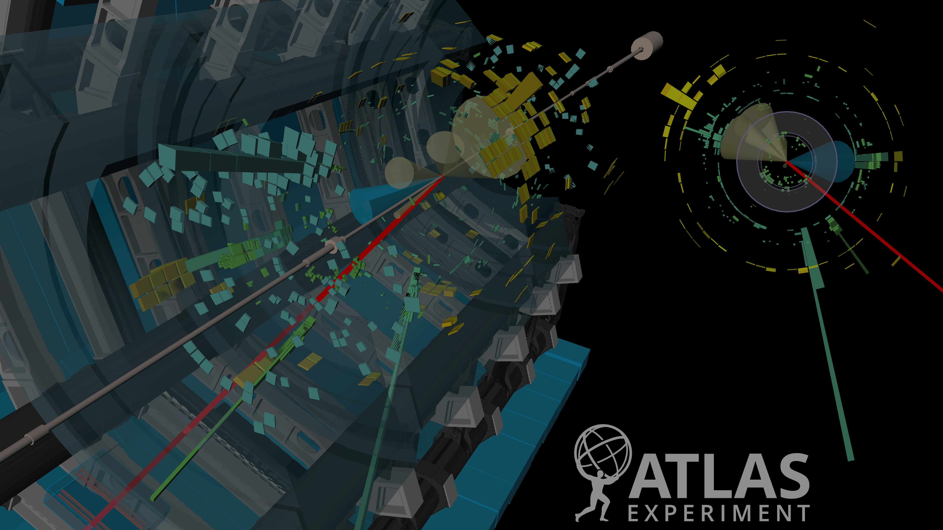

Machine Learning Higgs Particle Detection
By Evangelos Giakoumakis

Slide 2
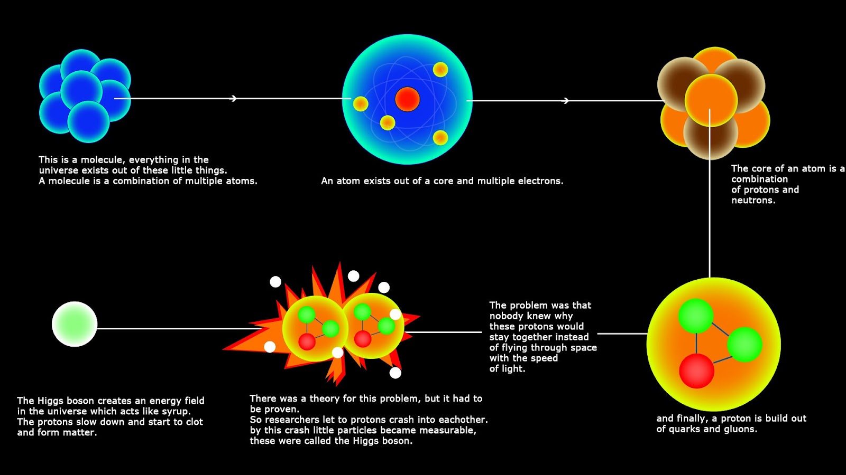
Physics
Physics Background

Slide 3
Introduction
The ATLAS experiment recently claimed the discovery of the Higgs boson. The discovery was acknowledged by the 2013 Nobel prize in physics given to Francois Englert and Peter Higgs.
This particle was theorized almost 50 years ago to have the role of giving mass to other elementary particles. It is the final ingredient of the Standard Model of particle physics, ruling subatomic particles and forces.
The experiments are running at the Large Hadron Collider (LHC) at CERN (the European Organization for Nuclear Research), Geneva, which began operating in 2009 after about 20 years of design and construction.

Slide 4
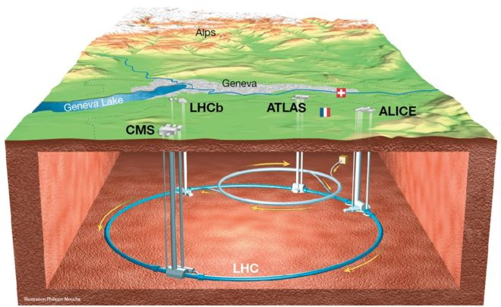
Experiment
In the LHC, proton bunches are accelerated on a circular trajectory in both directions. When these bunches cross in the ATLAS detector, some of the protons collide, producing hundreds of millions of proton-proton collisions per second. The up to hundreds of particles resulting from each bunch crossing (called an event) are detected by sensors, producing a sparse vector of about a hundred thousand dimensions. From this raw data, the type, the energy, and the 3D direction of each particle are estimated.

Slide 5
Detection
A large majority of the saved events, represent known processes (called background): they are mostly produced by the decay of particles which are exotic in everyday terms, but known, having been discovered in previous generations of experiments. The goal of the offline analysis is to find a (not necessarily connected) region in the feature space in which there is a significant excess of events (called signal) compared to what known background processes can explain. Once the region has been fixed, a statistical (counting) test is applied to determine the significance of the excess. If the probability that the excess has been produced by background processes falls below a limit, the new particle is deemed to be discovered.

Slide 6
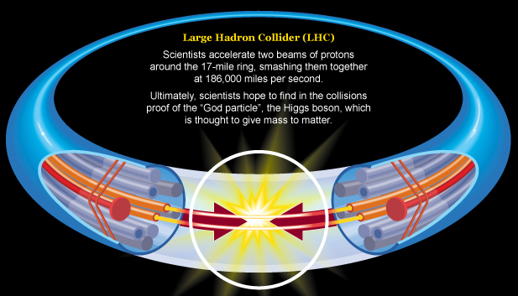
Goal
The goal of this project is to improve the procedure that produces the selection region (separating background and signal events). A training set with signal/background labels and weights was provided. Additionally a test set (without labels and weights) was given, and a formal objective representing an approximation of the median significance (AMS) of the counting test.

Slide 7
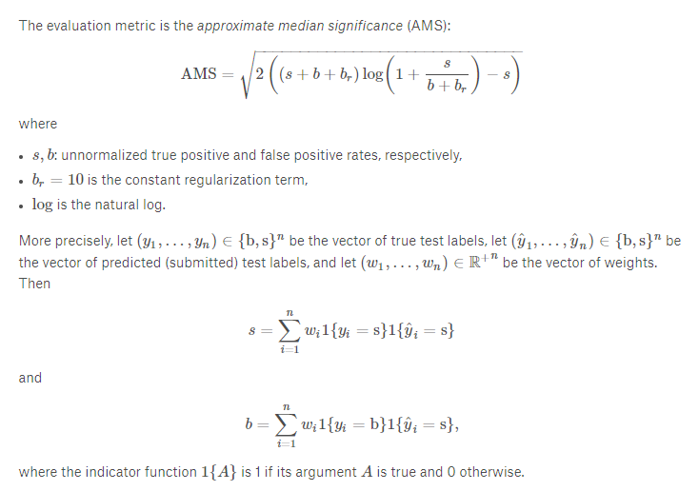
Evaluation Metric

Slide 8
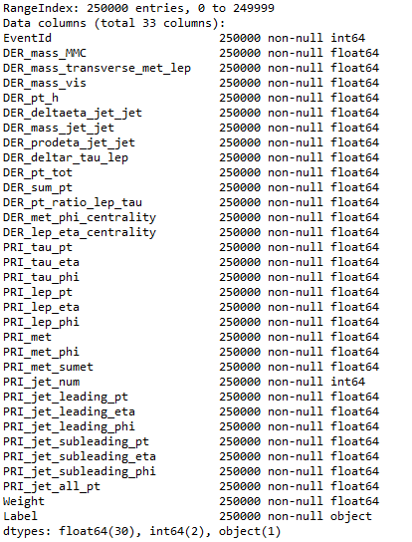
Data
training.csv - Training set of 250000 events, with an ID column, 30 feature columns, a weight column and a label column.
test.csv - Test set of 550000 events with an ID column and 30 feature columns.

Slide 9
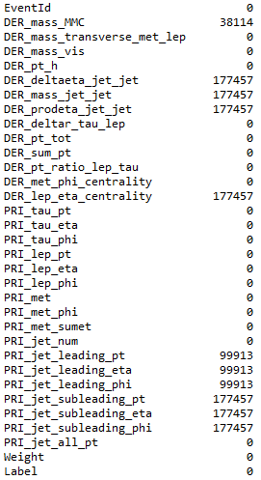
Exploratory Data Analysis
Issues:
- Many missing values (-999)
Solutions:
- Mean Imputation
- Median Imputation
- Most frequent Imputation (*)
Scaling:
- Standard Scaler

Slide 10
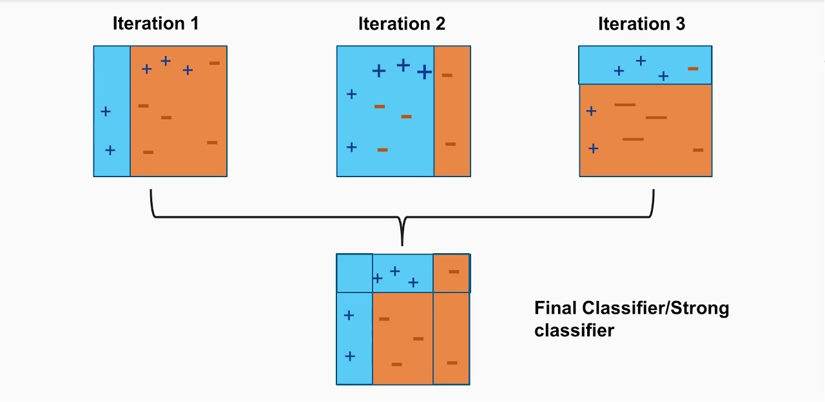
Model (Adaptive Boosting)
AdaBoost, is a machine learning algorithm that can be used in conjunction with many other types of learning algorithms to improve performance. The output of the other learning algorithms ('weak learners') is combined into a weighted sum that represents the final output of the boosted classifier. AdaBoost is adaptive in the sense that subsequent weak learners are tweaked in favor of those instances misclassified by previous classifiers.

Slide 11
Model Selection Criteria
The AdaBoost model was selected because:
it supports weighted examples in Sci-kit learn library.
it excels at making the model focus on the incorrect examples.
It was used in conjunction with ExtraTreesClassifier since:
it greatly benefits from subsampling the large number of examples present.

Slide 12
Model Details
classifier = AdaBoostClassifier(
n_estimators = 20 - maximum number of estimators at which boosting is terminated
learning_rate = 0.75 – it shrinks the contribution of each classifier (trade-off with estimators)
base_estimator = ExtraTreesClassifier( - base estimator from which the boosted ensemble is built
n_estimators = 400 - collection of fitted sub-estimators
max_features = 30 - number of features to consider when looking for optimum split
max_depth = 12 - maximum depth of the individual regression estimators
min_samples_leaf = 100 - minimum number of samples required to be at a leaf node
min_samples_split = 100 - minimum number of samples required to split an internal node
))

Slide 13
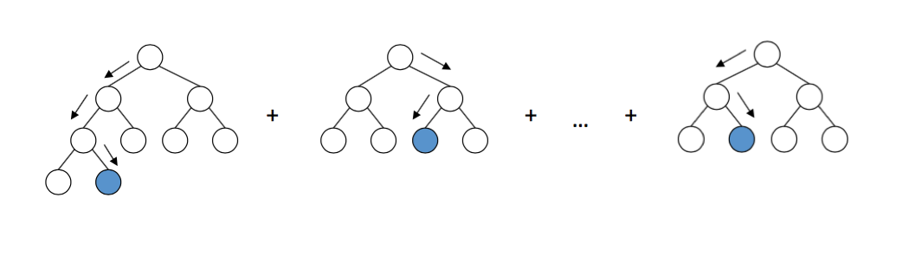
Model (Gradient Boosting)
Gradient Boosting is a machine learning technique for regression and classification problems, which produces a prediction model in the form of an ensemble of weak prediction models, typically decision trees. It builds the model in a stage-wise fashion and it generalizes them by allowing optimization of an arbitrary differentiable loss function.

Slide 14
Model Selection Criteria
The Gradient Boosting model was selected because:
it supports weighted examples in Sci-kit learn library.
it excels at making the model focus on the weak learners.
it increases the accuracy by minimizing the loss function(error which is the difference of actual and predicted value.)

Slide 15
Model Details
gbc = GBC(
n_estimators=60 - maximum number of estimators at which boosting is terminated
max_depth=5 - maximum depth of the individual regression estimators
min_samples_leaf=200 - minimum number of samples required to be at a leaf node
max_features=9 - number of features to consider when looking for optimum split
learning_rate=0.65 - it shrinks the contribution of each classifier (trade-off with estimator
)

Slide 16
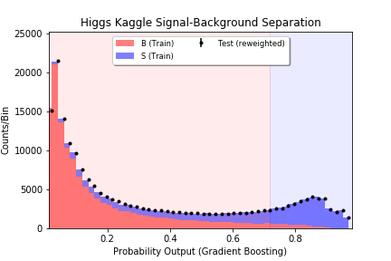
Gradient Boosting Model Visualization

Slide 17
Results
GradientBoost
Score: 0.838
AMS: 3.26
Kaggle Score: 3.11
Runtime: ~12 mins
AdaBoost
Score: 0.983
AMS: 3.65
Kaggle Score: 3.62
Runtime: ~4 hrs 25 mins
Adaptive Boosting produced the best overall results (highest AMS and Kaggle scores) but was computationally expensive (very slow).
Gradient Boosting was computationally inexpensive (very fast) and produced decent results but was less accurate than Adaptive Boosting.

Slide 18
Conclusion
We were able to effectively detect the Higgs Bosson using Boosting techniques (Adaptive and Gradient Boosting) by predicting if a given event is a signal or background.
It is not possible to reproduce all of the complexities of the search for the signal process in the Challenge. In particular, some simplifying assumptions are made concerning the treatment of uncertainties in the estimated rates of background processes. Furthermore, the search is carried out by counting the number of events found satisfying certain criteria; one may extend this to multiple counts with different criteria or to use of a more sophisticated likelihood-ratio test.

Slide 19

Questions

Slide 20
References
https://www.kaggle.com/c/higgs-boson
https://www.space.com/41654-higgs-boson-decays-bottom-quarks.html
https://looneyatoms.com/2012/12/08/travel-theme-circles-the-biggest-man-made-circle-in-the-world/cernmap/
https://www.kaggle.com/pranav84/a-beginner-s-guide-to-cern-s-trackml-challenge
http://ablazeiasacademy.com/higgs-boson-god-particle/
https://www.packtpub.com/mapt/book/big_data_and_business_intelligence/9781788295758/4/ch04lvl1sec32/adaboost-classifier
http://arogozhnikov.github.io/2016/06/24/gradient_boosting_explained.html
https://github.com/log0/higgs_boson

